Slide 1


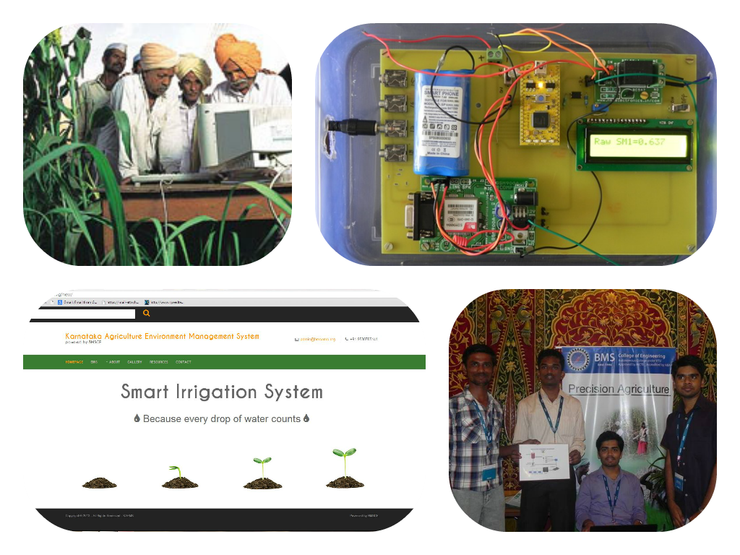
SMART AGRICULTURE
DEPARTMENT OF ELECTRONICS & COMMUNICATION
IN COLABORATION WITH
DEPARTMENT OF CIVIL ENGINEERING
Agriculture may be the backbone of Indian economy yet is unfortunately at the of backdoor Indian gate
Smart Agriculture is arguably an affordable boon dedicated to our beloved farmers
Not just available as a real time monitoring but also on web around the globe in this internet driven era
2nd runner up at the ARM symposium is just the needed motivation of many more to follow

